Slide 1
Network Board – June 2017
Network Team Update

Slide 2
National Context Update
NHS England consultation extended to 17 July 2017 due to general election
NHS England visit to UHB Mon 19th June. UHW visit has taken place
Leeds are appointing a network manager and exploring lead nurse role
NICOR are ceasing validation visits, which has raised concern in the CRG
CRG update: AT to add

Slide 3
Patient engagement – themes and next steps
We have attended 4 paediatric and 2 adult clinics
Themes emerging from talking to patients are
Need for access to cardiac, general and charity information
Split of need between surgical and non-surgical patients
Who to contact?
The role of the patient reps – maximising their input
Exploring JDs / roles in other services
Involvement in PPI events and contributing to newsletters and website
Advising with patient held record
Supporting service developments through virtual reference group

Slide 4
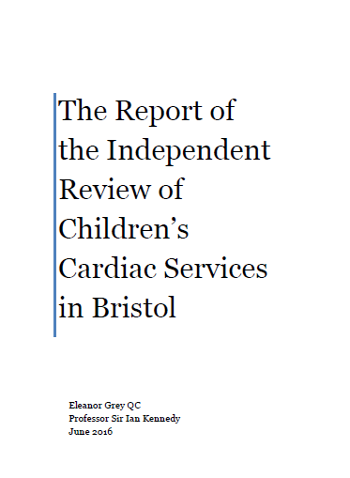
Bristol Independent Review
Management structure around review to close in June 2017 (12-months after publication)
The majority of recommendations have been completed and closed
A useful visit to Guy’s & St Thomas’ took place for peer learning
A small number of network specific actions remain ongoing and will sit with the Network Board for assurance of completion
An interim report on progress has been published, with a final report due after June

Slide 5
Education & Training – Upcoming Dates
Children’s Nurses | Adult Nurses
15th Introduction to Congenital Heart Disease 3rd-7th July G.O.S www.introtochd.co.uk | 15th Introduction to Congenital Heart Disease Including specific ACHD day. G.O.S 3rd-7th July ACHD day 7th July www.introtochd.co.uk
Paediatric Cardiac Study day for ward nurses and Community and ward nurses UHBristol Education Centre 17/11/2017 FacultyOfChildrensNurseEducation@UHBristol.nhs.uk | Adult Congenital Heart Disease Study Day UHBristol Education Centre 17/9/2017
5th Annual CCNA Conference 21 June 2017 Booking email j.fleet@worc.ac.uk; | Regional training days
British Congenital Cardiac Association, conference November 2017 London www.bcs.org | British Congenital Cardiac Association, conference November 2017 London www.bcs.org
RCN competencies for Band 5 and 6 Children and young people’s cardiac nursing www.rcn.org.uk | RCN competencies for Band 5 and 6 Adult Congenital heart disease nursing www.rcn.org.uk
Shadowing in Level 1 centre, wards, JCC, OPD | Shadowing in Level 1 centre, wards, JCC, OPD

Slide 6
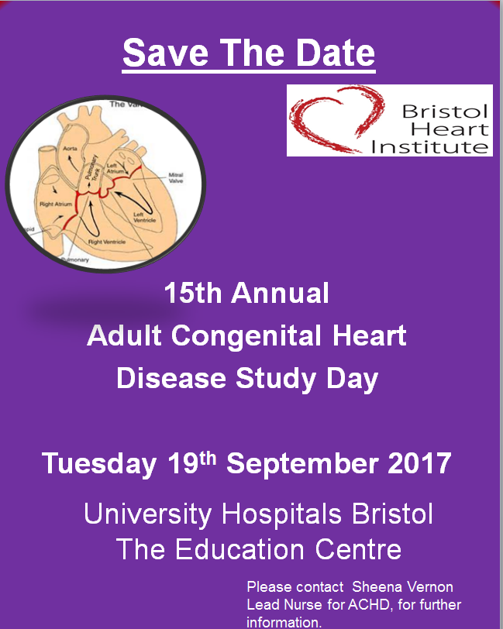
Education & Training – Upcoming Dates
Adult
Children

Slide 7
Governance
Risks and Incidents
1 incident reported related to sudden unexpected death following SVT – local investigation under way learning to be shared
Reminder to share any risks / incidents and to link any governance leads into network team
Audit:
No formal audit programme (to be established in 17/18)
C Carey in Torbay adult auditing adherence to FU protocols. Will share any benefits (e.g. reduced FU rates / efficiencies)
UHB and UHW are auditing compliance with one of the palliative care standards and will share learning
Any other audits proposed that could be shared?

Slide 8
Feedback on Network Board Meetings
Sent to all board members (40), including those who have not attended - 14 responses
Overall themes:
Boards have been useful and content seems about right
Useful to add fetal and psychology – Helen Liversedge invited to Sep Board. Psych on agenda
Perhaps more L2/L3 input as still a little Bristol focused (e.g. good examples and particular areas of challenge) – L2/3 best practice input to be added to Sep Board (e.g. Torbay adult review of protocols)
Presence of patients / support groups v valuable for reality check. Could do with a specific patient story / experience each meeting
A mid morning 5-minute break felt to be useful
Question over whether memberships will need to slim down over time, but felt to be about right for now
Workshops have been helpful both for service development and CPD
Suggestions for topics: exercise prpescriptions, relaity of attending for surgeyr
Early signs of progress seem good but need to see this in action (?measured) at a local level
Venue was suitable (larger is better), with remote access important, thought it was felt to be a little clunky / hard to interact at the Taunton meeting
Patient reps felt listened to and welcomed (though some acronyms were not understood), but would like more clarity about what we want from them

Slide 9
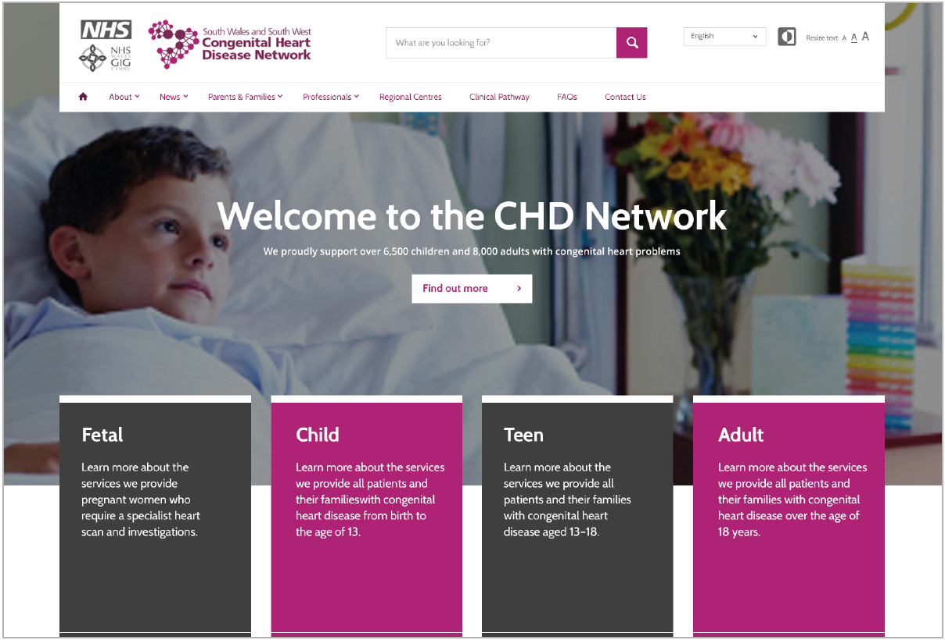
Network Website – example slides

Slide 10
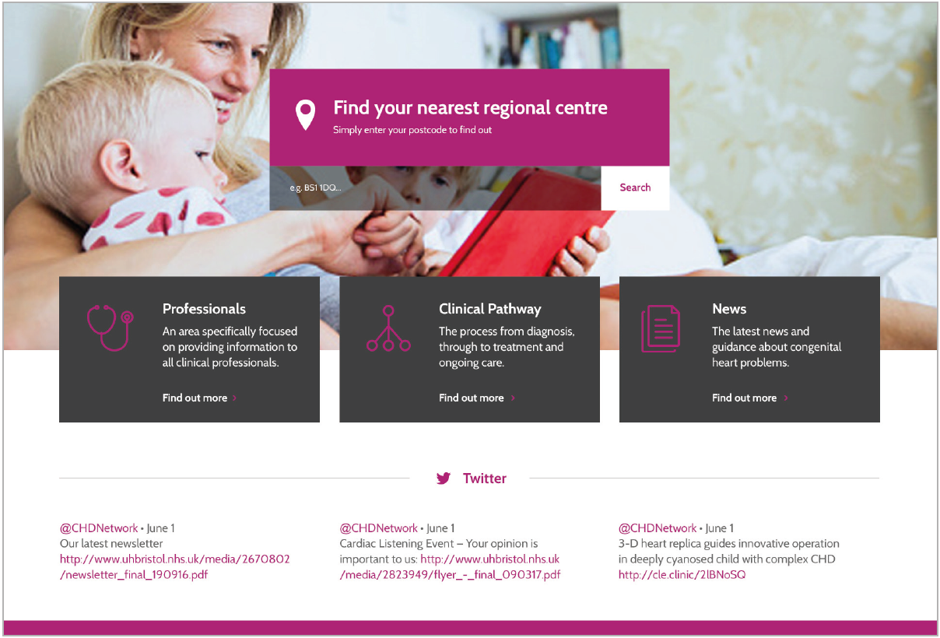
Network Website – example slides

Slide 11
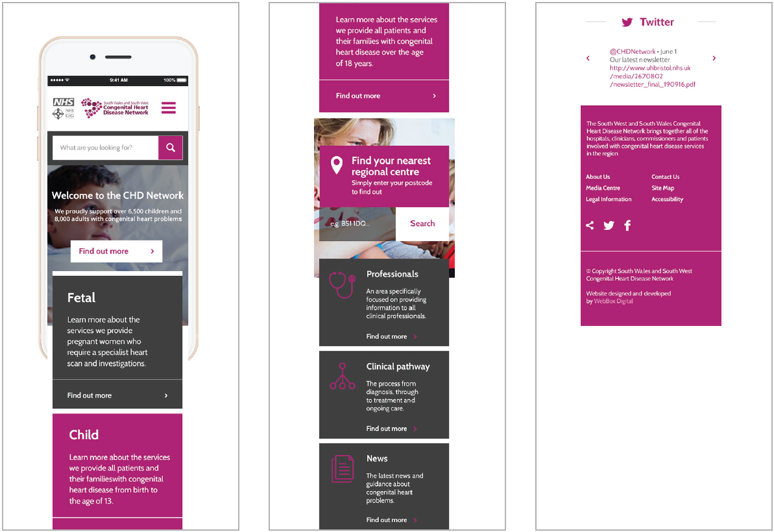
Network Website – example slides

Slide 12
Image Sharing & Patient Held Records
AT to update slide

