Slide 1
Palliative Care / Parallel planning
Francis Edwards
Paediatric Palliative Care and Bereavement Support Team
Bristol Royal Hospital for Children
Notes:
Introduce ourselves/ the team/ roles

Slide 2
The aim of paediatric palliative care
To help children with life-limiting and life-threatening illnesses and their families achieve a good life and a good (enough) death
Notes:
Planning for EOL care is important but it absolutely should not form the whole of palliative care. We have a responsibility to ensure that for those children who are life-threatened that we are ensuring that their lives are of as good quality as they can be which means addressing all domains of their and their family’s suffering – physical, spiritual, psychological, social by providing holistic care.

Slide 3
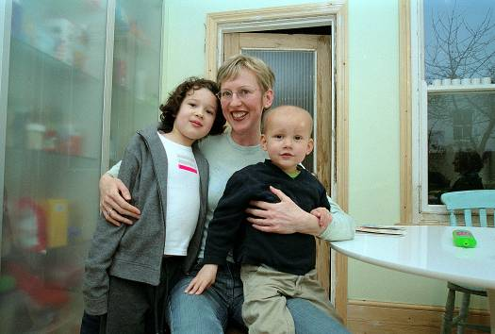
The aim of the work is to leave families with what can only be described as a “good enough” memory of the life, dying and death of their child or in some cases children...
Notes:
I would hope to see the …

Slide 4
Introducing palliative care…
This should not be seen as nothing more can be done or come across as a sense of giving up…
Palliative care is not a diagnosis or single intervention; it is a philosophy of care. It can be seen as a thread that weaves through the lives of all children with a life limiting / life-threatening illness / condition alongside active interventions and treatment…

Slide 5
What is palliative Care…
Paediatric Palliative Care is care that maximises the comfort, wellbeing and quality of life of children with a life-limiting illness, and of their family and carers. It is very different to End-of-life care.
Palliative care does not begin at the end of life but is involved from the time a child is diagnosed with a life-limiting illness.
End-of-life care is the end stage of palliative care where the child is very close to death.

Slide 6
What are we talking about…
An active and total approach to care, from the point of diagnosis or recognition, throughout the child’s life, death and beyond.
It embraces physical, emotional, social and spiritual elements and focuses on the enhancement of quality of life for the child and support for the family.
It includes the management of distressing symptoms, provision of short breaks and care through death and bereavement. (ACT 2009)

Slide 7
Active treatment
Palliative care
Diagnosis
Curative treatment ceases
Death
Notes:
This is the model that has historically and in many cases continues to be followed
Once a child has reached the point that they are dying – in the last days, hours of life and a decision has been that to continue life-sustaining treatment is not longer in the interest of that child then that holistic care focussing on that child’s EOL care and starting to understand what is important to that child and family begins, EOL care planning begins and plans for care in bereavement might be made. In some cases there isn’t enough time for those wishes to be fulfilled (eg child dies in hospital, in an intensive care environment rather than at home/hospice)
In this situation there is potential for this line to move further and further this way in the pursuit , potentially unrealistic pursuit, of a cure and thus creating a barrier to the benefits of palliative care

Slide 8
Active treatment
Palliative care
Diagnosis
Death
Notes:
Parallel planning – hoping for the best (continuing life sustaining treatments) yet planning for the worst so that we are being honest and enabling families to engage in informed decision making and I think, if done well, this process protects them from looking back and thinking they gave up on their child or could have done more but also allows them to create good memories and have an experience of their child’s death that is good enough…
The focus of parallel planning is not and should not be just about the end of life

Slide 9
Why parallel plan?
‘Parallel planning for life while also planning for deterioration or death allows a child’s full potential to be achieved and primes the mobilization of services and professionals where necessary’

Slide 10
Why parallel plan?
Parents of critically ill children believe it important to have honest and direct communication with healthcare providers
Opportunity to make decisions with familiar professionals in a timely way
EOL consistent with patient preferences & better rating of the dying experience (adults)
Opportunity for statement of wishes about place of care & death
May open previously unvisited conversations
Notes:
Parallel planning for life while also planning for deterioration or death allows a child’s full potential to be achieved and primes the mobilisation of services and professionals where necessary. Planning for the future at times of great uncertainty can also be comforting for children and parents.
May help families to communicate amongst themselves about death/dying – what might have otherwise remained unspoken – may help with the grieving process and improve realistic hope and resilience

Slide 11
Barriers to ACP
Unrealistic parent expectation
Differences between patient/parent and clinician understanding of prognosis
Lack of parent readiness
Clinician not knowing when to address the issue
Prognostic uncertainty
Clinician concern about taking away hope
Notes:
Physicians and nurses in the USA surveyed (Boston, in areas where ACP commonly takes place) – intensive care units, oncology teams

Slide 12
Who?
Diagnosis or recognition of life limiting/threatening condition
Would you be surprised if this baby / child died as a result of this condition or problem?
Death before adulthood
Would you be surprised if this baby/ child died before adulthood (18th birthday)?
Increasing instability
Would you be surprised if this baby / child died in the next few months to years?
Critical illness or end of life
Would you be surprised if this baby / child dies in the next few days / weeks?
If your answer is ‘NO, I would not be surprised’ to any of these questions you should be thinking about palliative care for this child or young person.

Slide 13
Category 1. | Uncomplicated disease, with expected excess mortality <1%. | Diagnostic cardiac catheterisation Interventional cardiac catheterisation ASD, PDA closure Balloon dilation pulmonary valve Electrophysiology intervention for SVT Pacemaker insertion Medical Treatment of arrhythmia
Category 2. | Uncomplicated disease but undergoing surgical or catheter intervention. Mortality 1-5% in 5 years You would be surprised if they died | Interventional cardiac catheterisation Balloon dilation of aortic valve Stent insertion aorta, branch pulmonary artery Electrophysiological intervention in infancy Cardiac surgery after 1 year old
Category 3. | Complex heart disease or co-morbidities such that mortality is a real but unlikely possibility. Mortality 5-20% in 5 years A few children will die of this each year | Complex Catheter intervention Stent insertion to Fallot outflow tract Radiofrequency perforation Pulmonary Valve Hybrid intervention Cardiac surgery - Neonatal Arterial switch, TAPVC
Category 4. | Complex heart disease or co-morbidities. A high chance of mortality or serious complication. Mortality >50% in 5 years. You would not be surprised if they died | Cardiac surgery : Neonatal complex intervention Atrial isomerism Common arterial trunk Hypoplastic left heart Norwood
Notes:
So, can we be more specific in doing this for children with cardiac disease? This table comes from a paper written by Rob Tulloh and Francis which describes parallel planning for this patient group, In this table they have categorised diseases according to their excess mortality due to their cardiac disease.
Now, of course this is a guide but what they are hoping to do here is suggest in which patient groups parallel planning should be considered high on the priority list acknowledging that for many patients it will not be appropriate (group 1 and 2) to have such conversations but for some (in groups 3 and 4) we have a responsibility to enable those conversations to take place

Slide 14
How
Recognise the need
Create space & listen
Support families and each other to live with uncertainty
Plans should not only focus on end of life
Communication
Notes:
Recogising the need – at the point of diagnosis
Create space - for families to talk, time is often sited as a barrier to having these conversations but I think if we try not to fill the time talking but focus on listening then families often will talk about these issues and it doesn’t take a lot of time..
Planning EOL care is an important part of palliaitve care but it isn’t the only part – focussing on optimising QOL and empowering families to make decisions that enable that to happen can turn what can be a difficult and sad process into one that brings some hope for them – now this might be about religning hope – hoping for something different, being out of hospital, being pain free, being outside but it isn’t about destroying hope
We do have a reponsibility to be realistic about choices offered though – we mustn’t overpromise and have a duty to do the informaiton gathering first about what might be possible (eg palliativie care at home) before offering it to families
Communication – must be honest, timely, there must be consistent messages between team members. The conversations might take place with a core group of professionals but the plans need to be documented and shared with the wider team

Slide 16
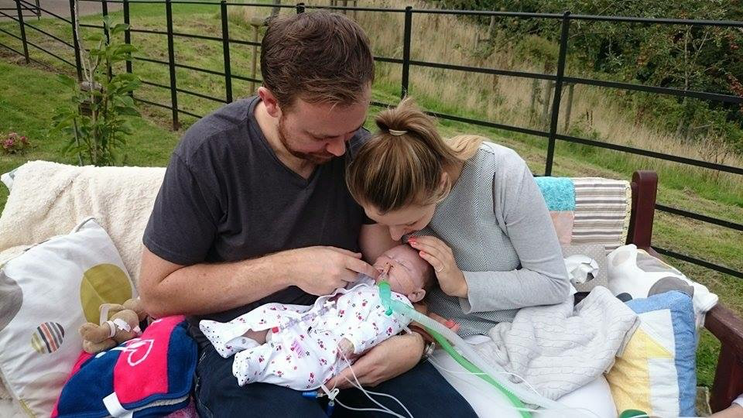
‘We were then granted my one wish, to take our little girl into the
sunshine for a big cuddle and kiss before saying goodbye ...’

